Slide 1


Wellcome To Ethical Hacking class 3rd Week Day 4th

Slide 2


Enumeration Tools and Scanners
Definition:
Enumeration in cybersecurity refers to the process of gathering information about a target system, including details about network resources, shares, and services. It is a crucial step in penetration testing and ethical hacking to identify vulnerabilities and weaknesses.
Examples:
Gathering Network Shares:
Using tools like `NetBIOS` to list shared resources on a network, such as folders and printers.

Slide 3

Enumeration Tools and Scanners
Examples:
User Accounts Enumeration:
Using LDAP to extract user accounts and organizational units from a directory service.
Techniques and Tools:
Nmap: A network scanning tool that can identify live hosts, open ports, and services running on those ports.
Netcat: A versatile tool for network exploration and debugging.
Metasploit Framework: Offers a range of enumeration modules for different protocols.
Websites:
[Nmap Official Website]https://nmap.org
[Metasploit Framework]https://www.metasploit.com

Slide 4

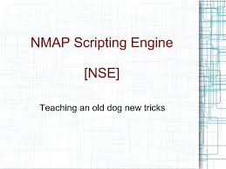
Nmap Scripts for Enumeration
Definition:
Nmap Scripting Engine (NSE) is a powerful feature of Nmap that allows users to write and use scripts for advanced scanning and enumeration tasks.
Examples:
SMB Enumeration: Using `smb-enum-shares` script to list SMB shares on a target machine.
DNS Enumeration:Using `dns-brute` script to perform DNS brute-forcing and discover subdomains.
Techniques and Tools:
NSE Scripts: Use built-in Nmap scripts for various protocols like HTTP, SMB, SNMP, etc.
[Nmap NSE Documentation](https://nmap.org/book/nse.
html

Slide 5

SNMP Enumeration Tools
Definition:
SNMP (Simple Network Management Protocol) enumeration is the process of querying SNMP-enabled devices to extract valuable information like device configurations, software versions, and network interfaces.
Examples:
Device Information Gathering:
Using SNMPwalk to retrieve system information like uptime, contact, and location.
Network Interface Enumeration:
Using SNMP to list interfaces and their configurations on a router.

Slide 6
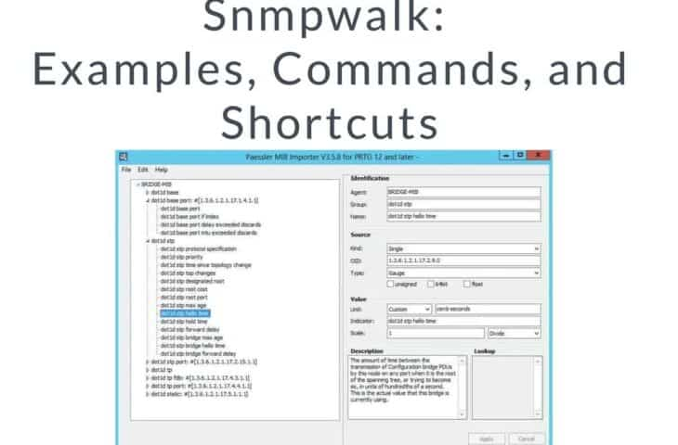
SNMP Enumeration Tools
Techniques and Tools:
SNMPwalk: A command-line tool used to query SNMP-enabled devices.
OpenSNMP: A suite of SNMP tools for scanning and enumeration.
Websites:
[SNMPwalk Tool]http://www.net-snmp.org/docs/man/snmpwalk.html

Slide 7

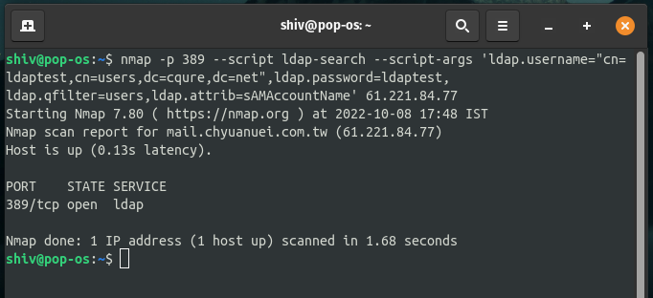
LDAP Enumeration Tools
Definition:
LDAP (Lightweight Directory Access Protocol) enumeration involves querying LDAP directory services to extract information about users, groups, and organizational units.
Examples:
User Enumeration:
Extracting a list of user accounts from an Active Directory using LDAP.
Group Enumeration:
Retrieving information about security groups and their members.

Slide 8
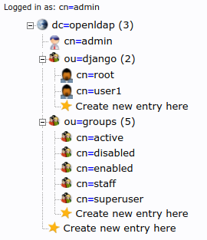
LDAP Enumeration Tools
Techniques and Tools:
ldapsearch: A command-line tool to query LDAP directories.
JXplorer: A Java-based LDAP browser for exploring directory services.
Websites:
[JXplorer LDAP Browser]http://jxplorer.org

Slide 9

SMB Enumeration Tools
Definition:
SMB (Server Message Block) enumeration is the process of discovering information about SMB services on a network, such as shared files and folders.
Examples:
Share Enumeration:
Listing shared folders on a Windows server using SMB enumeration tools.
User Enumeration:
Extracting a list of users and groups with access to SMB shares.

Slide 10
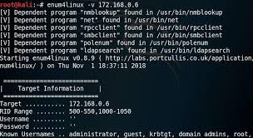
SMB Enumeration Tools
Techniques and Tools:
Enum4linux: A tool to enumerate SMB shares, users, and group policies on Windows systems.
SMBmap: A tool for assessing the access level of SMB shares.
Websites:
[Enum4linux]https://tools.kali.org/information-gathering/enum4linux

Slide 11

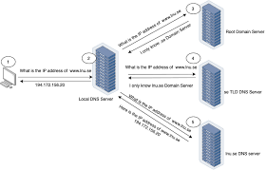
DNS Enumeration Tools
Definition:
DNS enumeration involves querying DNS records to gather information about domain names, IP addresses, and other related data.
Examples:
Subdomain Enumeration:
Discovering subdomains of a target domain using brute-forcing or zone transfers.
Record Retrieval:
Retrieving DNS records such as MX, A, and TXT for a target domain.

Slide 12

DNS Enumeration Tools
Techniques and Tools:
Dig: A command-line tool for querying DNS records.
Fierce: A DNS reconnaissance tool for discovering subdomains and misconfigurations.
Websites:
[Fierce](https://tools.kali.org/information-gathering/fierce

Slide 13
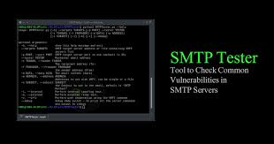
SMTP Enumeration Tools
Definition:
SMTP (Simple Mail Transfer Protocol) enumeration is the process of interacting with an SMTP server to gather information about its configuration and user accounts.
Examples:
User Enumeration:
Using the `VRFY` command to check if an email address exists on the server.
Banner Grabbing:
Retrieving the SMTP server banner to identify the software version.

Slide 14
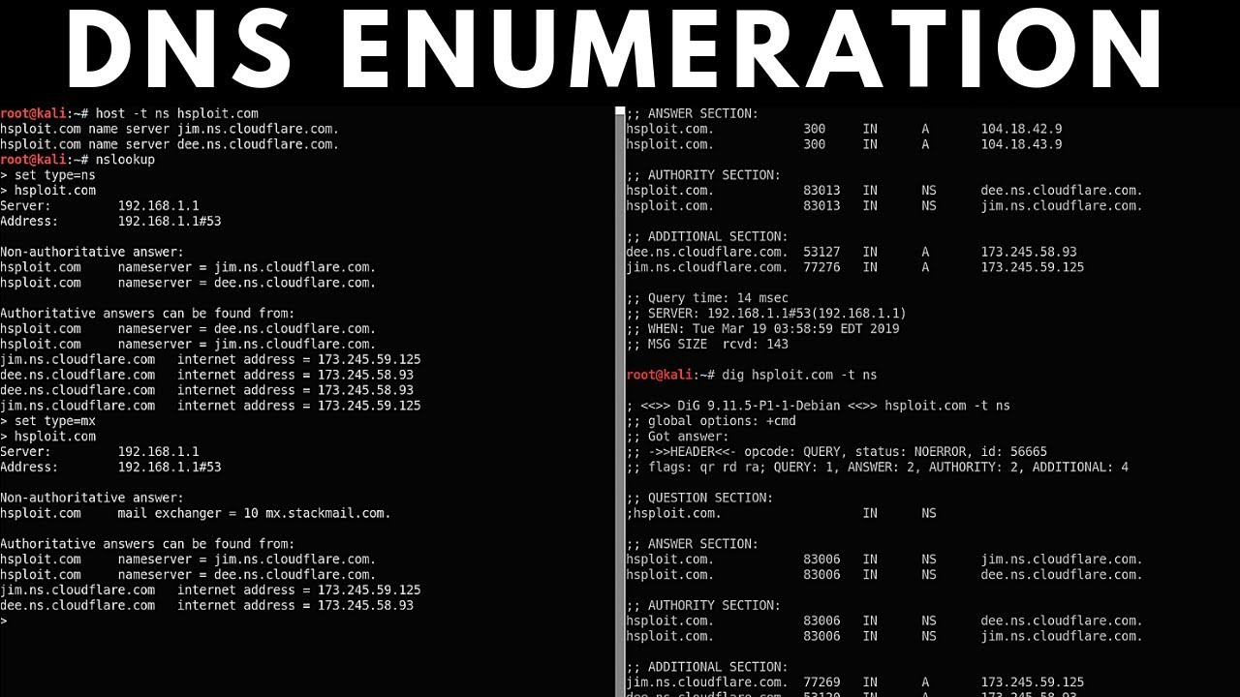
DNS Enumeration Tools
Techniques and Tools:
Telnet: A command-line tool to interact with SMTP servers and perform manual enumeration.
smtp-user-enum: A tool for enumerating users on an SMTP server.
Websites:
[smtp-user-enum]https://tools.kali.org/information-gathering/smtp-user-enum

Slide 15
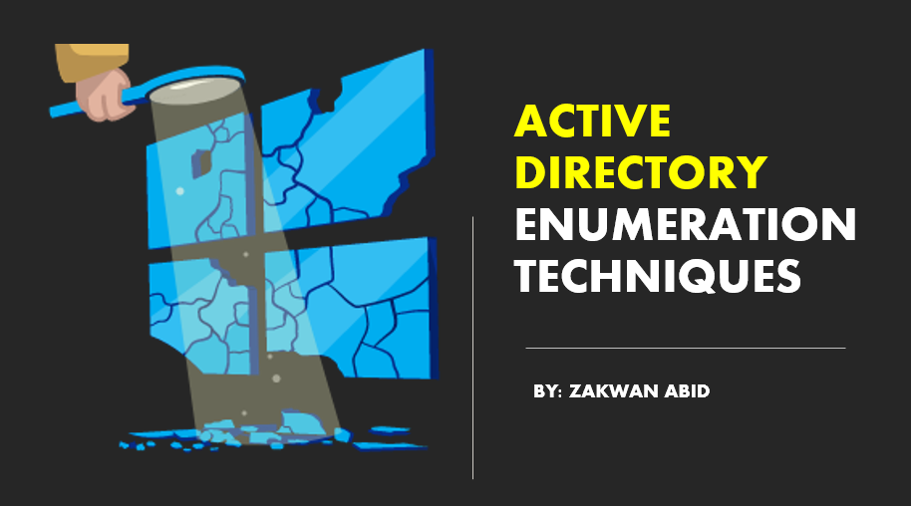
Enumeration for Active Directory
Definition:
Active Directory enumeration involves querying an Active Directory environment to gather information about its structure, users, groups, and policies.
Examples:
User and Group Enumeration:
Extracting lists of users and security groups within an Active Directory domain.
Policy Enumeration:
Retrieving Group Policy Objects (GPOs) applied to users and computers.

Slide 16
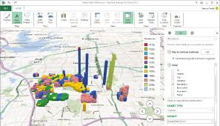
Enumeration for Active Directory
Techniques and Tools:
BloodHound: A tool for analyzing Active Directory trust relationships and identifying potential attack paths.
PowerView: A PowerShell tool for Active Directory enumeration.
Websites:
[BloodHound GitHub]https://github.com/BloodHoundAD/BloodHound

Slide 17
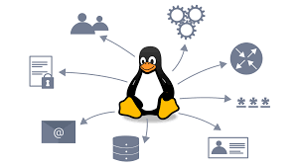
Enumeration for Linux
Definition:
Linux enumeration involves gathering information about a Linux system, including its users, groups, services, and configurations.
Examples:
User Enumeration:
Listing all user accounts on a Linux system.
Service Enumeration:
Identifying running services and their configurations.

Slide 18
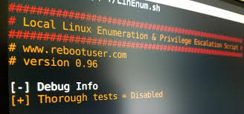
Enumeration for Active Directory
Techniques and Tools:
LinEnum: A script that performs various enumeration tasks on a Linux system.
Linux Exploit Suggester: A tool that suggests potential exploits based on system enumeration.
Websites:
[LinEnum GitHub]https://github.com/rebootuser/LinEnum

Slide 19

Enumeration for Windows
Definition:
Windows enumeration involves gathering information about a Windows system, including user accounts, groups, services, and configurations.
Examples:
User and Group Enumeration:
Listing all user accounts and security groups on a Windows machine.
Service Enumeration:
Identifying installed services and their statuses.
Techniques and Tools:
WinPEAS: A script for privilege escalation and enumeration on Windows systems.
Sysinternals Suite: A collection of Windows utilities for system diagnostics and enumeration.
Websites:
[Sysinternals Suite](https://docs.microsoft.com/en-us/sysinternals/)

Slide 20
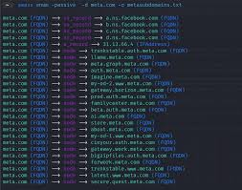
Enumeration Best Practices
Definition:
Enumeration best practices refer to the guidelines and techniques that ensure effective, efficient, and ethical information gathering.
Examples:
Minimize Noise:
Use targeted enumeration to avoid generating excessive network traffic and alerts.
Prioritize Targets:
Focus on high-value systems and services that are more likely to yield useful information.

Slide 21
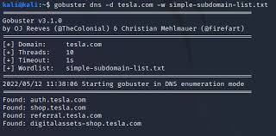
LDAP Enumeration Tools
Techniques and Tools:
Passive Enumeration: Use publicly available information before active scanning.
Use Filters: Apply filters to focus on specific protocols or services.

Slide 22

Enumeration Ethics and Legal Considerations
Definition:
Enumeration ethics and legal considerations involve conducting information gathering activities in a lawful and ethical manner, respecting privacy and legal boundaries.
Examples:
Obtain Permission:
Ensure proper authorization before conducting enumeration on a network.
Respect Privacy:
Avoid accessing or collecting sensitive information beyond the scope of the engagement.

Slide 23

Enumeration for Active Directory
Techniques and Tools:
Engagement Letters:
Use formal agreements to define the scope and limitations of enumeration activities.
Code of Conduct:
Adhere to ethical guidelines established by professional organizations like (ISC)² or EC-Council.

Slide 24


Muhammad Bilal

Slide 25

Happy Hacking

Slide 26
Thank You!

